Slide 1
My Alien Encounter
GROUP 2
Alice Baker Elliot Chester Heidi Falcon

Slide 2
The Game
Created to meet the Obscure Sorrows brief. Vellichor and Chrysalism.
Designed for PC with a 2 minutes game play.
The aim is to collect the book titled My Alien Encounter.
The game offers simple fun and simple mechanics to a demographic of adults 18- 27 both male and female.

Slide 3
The Mechanics
The game is one level and the player is given a maximum 2 minutes of energy at the beginning of the game.
The player needs to think ahead strategically to select the best path forward, avoid the dripping water, save the books and progress towards the door.
The game uses jumping mechanics and timing to move from platform to platform as some platforms are not static
The game ends when the alien score enough points to release door and finds the book.
Player is given a total of score, time and books saved and could try again to improve score or quit game.

Slide 4
The Alien
This alien is created human like so it implies that its movements would replicate human movements.
Game is inspired on the Victorian era to contrast with out of space objects.
The colours and textures chosen contrast with
The alien looses strength as rains falls on him.

Slide 5

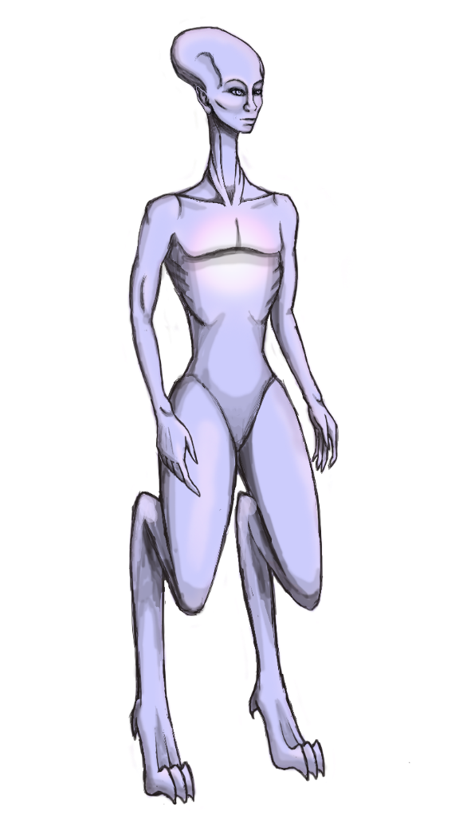

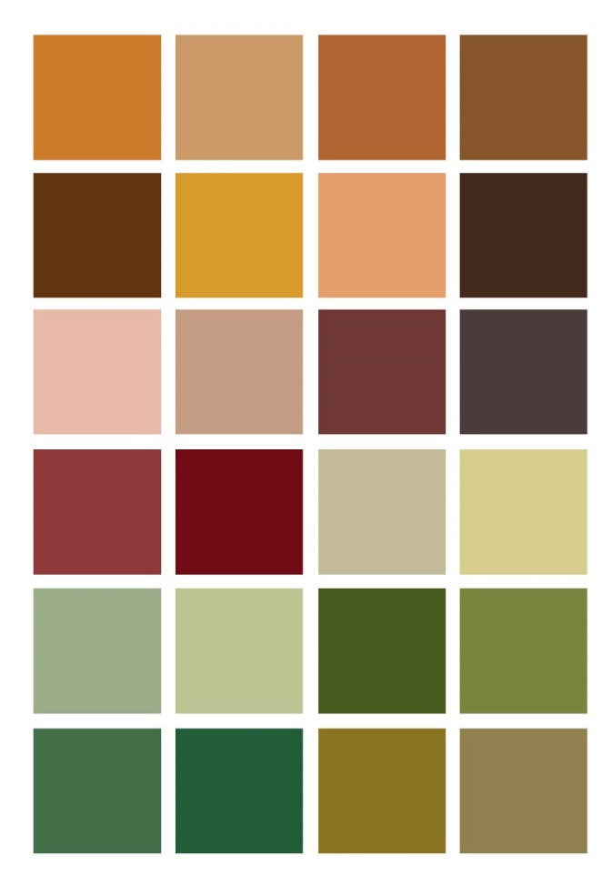
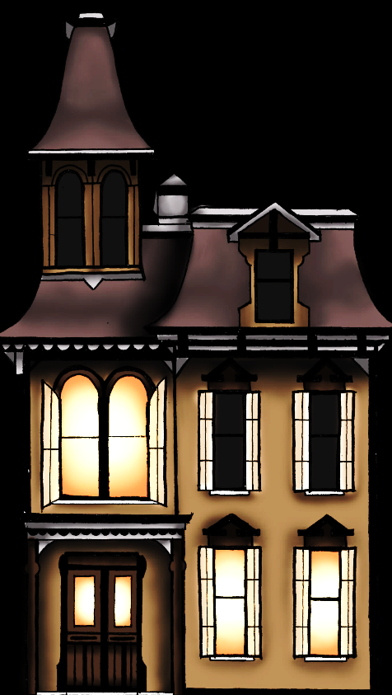

Assets Board

Slide 6
The Game

Slide 7
Questionnaire Feedback
What did you like?
100% liked design of game. 50% liked game play
What didn’t you like?
25% only one level, 75% simple mechanics.
Did you know what to do?
100% were clear on how to play the game.

Slide 8
Feedback cont.
What would you change?
100% would enjoy a more challenging game.
Would you play it again?
50% would, 50% would not.
Comments:
Game needs more challenging game play.

Slide 9
Lessons Learnt
Respect player’s knowledge and experience.
Challenge ourselves to explore further without over scoping.
Be critical of what we like not only what we don’t like.
We enjoyed working on a project of multiple experience levels.

Slide 10
Management Log
Emails: Alice: 15, Elliot: 5, Heidi: 23
Meetings: Alice: 14, Elliot: 10, Heidi: 15
Hours worked: Alice: 35, Elliot: 35, Heidi: 35

Slide 11
Any Questions?

